Slide 1
CSCM10: Presentation
Andrew Gray
445348

Slide 2
Contents
Motivation
Background Information
Aims of the Project
Project Steps
Current Steps
References
Q&A

Slide 3
Motivation
“It is predicted that by 2025, the global AI market is expected to be almost $60 billion; in 2016, it was just $1.4 billion. Another research says that AI bots will drive up to $33 trillion of annual economic growth and also power 85% of customer service interactions by 2020 [1].”
"Despite popular opinions, games promote learning and discourage negative behaviours. One study illustrates that regular gameplay improved mental health as well as cognitive and social skills [2].”

Slide 4
Motivation
Many people perceive ML to be a black box
A complex technique to master
underlining factors are relatively simple
Creating a teaching and learning tool that incorporates gamification features
Aim to debunk the misconceptions around AI and ML
By educating the concepts of ML in a fun and engaging way

Slide 5
Contents
Motivation
Background Information
Aims of the Project
Project Steps
Current Steps
References
Q&A

Slide 6
Background Information
Two main areas of Focus:
Gamification
Artificial Intelligence:
Machine Learning.
Picture Source: [3]
Picture Source: [4]

Slide 7
Background Information
Machine Learning
Supervised Learning
Unsupervised Learning
Different Algorithms (Models)
Picture Source: [5]

Slide 8
Background Information
Supervised Machine Learning
Provided a training set of data
Input data has matching output labels
The computer makes predictions
Takes new inputs
Provides outputs based on past events
Picture Source: [6]

Slide 9
Background Information
Unsupervised Machine Learning
Provided a training set of data
Input data does not have output labels
Algorithms will look for patterns
The computer makes predictions
Tend to be based on patterns
Picture Source: [7]

Slide 10
Background Information
Machine Learning Models:
Supervised:
Linear Regression
Logistic Regression
Support Vector Models
Unsupervised:
K-Means
Gaussian Mixture Models
Dimensionality Reduction
PCA and LDA
Picture Source: [8]
Picture Source: [9]
Picture Source: [10]

Slide 11
Background Information
Picture Source: [11]

Slide 12
Background Information
Jane McGonigal
TED Talk in 2010: “Gaming Can Make a Better World”
Spawned Gamification Research Network (GRN) at 2011 CHI conference
Picture Source: [12]

Slide 13
Background Information
Pokémon Go
Released in 2016
When gamification went viral and main stream
Broke Records
Picture Source: [13]
Picture Source: [14]

Slide 14
Background Information
Gamification
Leader boards
Levels
Challenges
Badges
Points
Check-in
Feedback
Picture Source: [15]

Slide 15
Contents
Motivation
Background Information
Aims of the Project
Project Steps
Current Steps
References
Q&A

Slide 16

Aims of the Project
Picture Source: [17]
Picture Source: [16]
Picture Source: [18]

Slide 17

Aims of the Project
Main Goal(s):
To teach different ML Algorithm’s traits
Achieved through game play and additional presented information
1 – 2 Players
An area for the player(s) to interact with (Click in)
Different ML models = different levels
Variety is based on what measure the algorithm is being checked
Pin the point on the decision boundary
Claim the screen
Guess the number of clusters

Slide 18
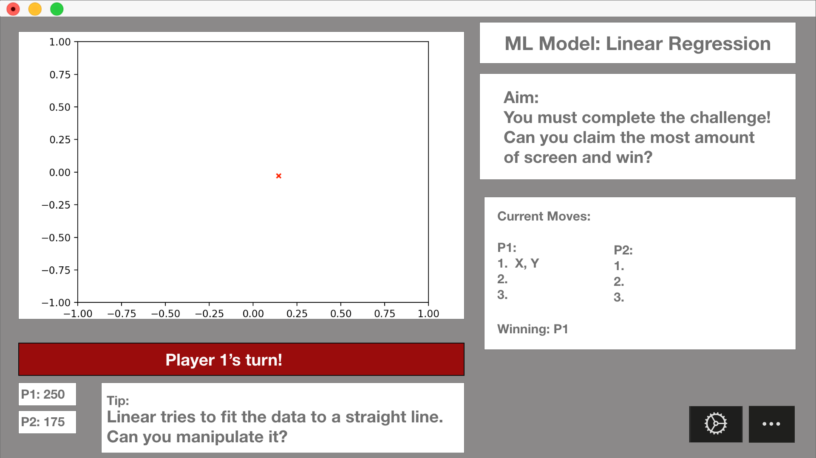
Aims of the Project

Slide 19

Aims of the Project

Slide 20
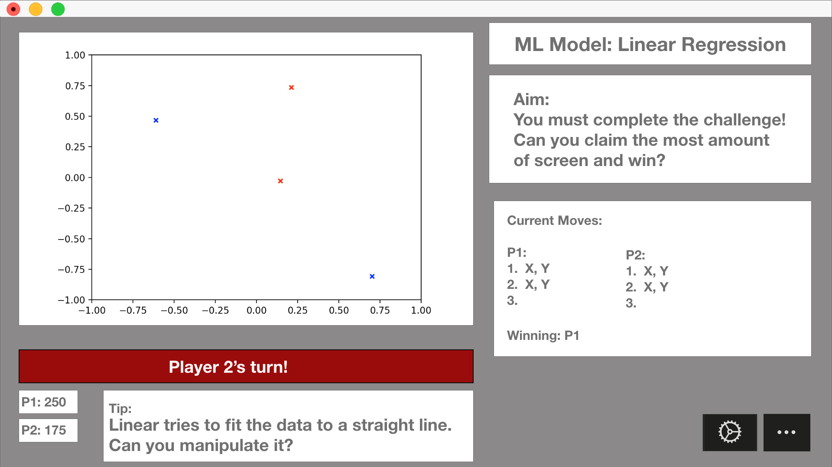
Aims of the Project

Slide 21

Aims of the Project

Slide 22
Contents
Motivation
Background Information
Aims of the Project
Project Steps
Current Steps
References
Q&A

Slide 23
Steps for the Project
Gain better fundamentals of Pygame
Start implementing the main game screen
Start implementing the ML model(s)
Start incorporating the ML model(s) into the game
Develop levels (Different Models)
Incorporate Multiplayer
Incorporate Learning Material(s) –
Websites/ Documents
Videos
Develop difficulty settings

Slide 24
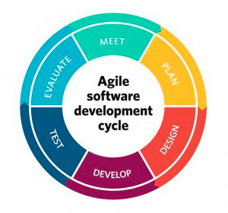
Steps for the Project
Methods:
Agile Approach
Kanban Tools
Tools:
Python
Jupyter Notebook
VS Code
Trello
Picture Source: [16]
Picture Source: [19]
Picture Source: [20]
Picture Source: [22]
Picture Source: [21]

Slide 25
Contents
Motivation
Background Information
Aims of the Project
Project Steps
Current Steps
References
Q&A

Slide 26
Current First Steps
Picture Source: [23]

Slide 27
Current First Steps
Picture Source: [24]

Slide 28
Contents
Motivation
Background Information
Aims of the Project
Project Steps
Current Steps
References
Q&A

Slide 29

Q&A
Picture Source: [25]

Slide 30
Contents
Motivation
Background Information
Aims of the Project
Project Steps
Current Steps
References
Q&A

Slide 31
References
S. Martin. (2019) Top industries getting revolutionised by artificial intelligence. [Online]. Available: https://medium.com/hackernoon/ top-industries-getting-revolutionised-by-artificial-intelligence-686a440857c0
S. Arnold. (2017) 10 important facts about games and learning. [Online]. Available: https://www.classcraft.com/blog/features/10-facts-games-learning/
Super Mario, Retrieved 13th March 2020. Picture, https://www.aliexpress.com/i/32893627970.html
BBC Computer Brain, Retrieved 9th March 2020. Picture, https://www.bbc.co.uk/newsround/49274918
Terminator, Retrieved 23rd March 2020. Picture, https://theboar.org/2019/12/terminator-dark-fate-is-the-series-best-since-judgement-day/
Robot Reading, Retrieved 9th March 2020. Picture, https://github.com/WillCheung2016
Unsupervised learning, Retrieved 23rd March 2020. Picture, https://techgrabyte.com/10-machine-learning-algorithms-application/
Logistic Regression, Retrieved 23rd March 2020. Picture, https://www.youtube.com/watch?v=zPG4NjIkCjc
SVM, Retrieved 23rd March 2020. Picture, https://towardsdatascience.com/support-vector-machines-for-classification-fc7c1565e3
Kmeans, Retrieved 23rd March 2020. Picture, https://mubaris.com/posts/kmeans-clustering/
Nick Pelling, retrieved 23rd March 2020. Picture, https://www.slideshare.net/ssuser542846/introduction-to-gamification-49726866
Jane McGonigal, retrieved 23rd March 2020. Picture, https://en.wikipedia.org/wiki/Jane_McGonigal

Slide 32
References
Pokémon Go action shot, retrieved 23rd March 2020. Picture, https://www.express.co.uk/entertainment/gaming/1093575/Pokemon-Go-How-to-get-Smeargle-easy-tips
Pokémon Go logo, retrieved 23rd March 2020. Picture, https://www.dexerto.com/pokemon/pokemon-go-spawn-points-changed-1068447
Gamification image, Retrieved 8th March 2020. Picture, https://hurix.com/selecting-gamification-services/
Python Logo, Retrieved 9th March 2020. Picture, https://www.pngfind.com/mpng/TJxTJR_python-logo-png-transparent-background-python-logo-png/
Pygame Logo, Retrieved 13th March 2020. Picture, http://www.pygame.org/docs/logos.html
Machine Learning Packages, Retrieved 13th March 2020. Picture, https://www.pyimagesearch.com/2019/01/21/regression-with-keras/
Agile, Retrieved 18th March 2020. Picture, https://project-management.com/10-key-principles-of-agile-software-development
VS Code, Retrieved 18th March 2020. Picture, https://en.wikipedia.org/wiki/Visual_Studio_Code
Jupyter Logo, Retrieved 18th March 2020. Picture, https://towardsdatascience.com/jupyter-lab-evolution-of-the-jupyter-notebook-5297cacde6b
Trello Logo, Retrieved 18th March 2020. Picture, https://trello.com/about/logo
Super Mario Bros. Level, Retrieved 13th March 2020. Picture, https://www.nintendo.co.uk/Games/NES/Super-Mario-Bros--803853.html
Brain Storm, retrieved 13th March 2020. Picture, https://ealdaylight.com/progressive-brainstorm/
Question mark, retrieved 1st March 2020. Picture, https://www.iconfinder.com/icons/3386485/%3F_%3F_pop_art_interrogation_message_bubble_interrogation_sign_question_mark_bubble_icon

Slide 33
References
Aurélien Géron. 2019.Hands-On Machine Learning with Scikit-Learn,Keras, and TensorFlow: Concepts, Tools, and Techniques to Build IntelligentSystems. O’Reilly Media.
J. McGonigal. (2010) Gaming can make a better world. [Online]. Available: https://www.ted.com/talks/jane_mcgonigal_gaming_can_make_a_better_world? language=en#t-1184578
Wikipedia. (2020) Gamification. [Online]. Available: https://en.wikipedia.org/wiki/Gamification
Growth Engineering. (2019) The history of gamification: From the very beginning to right now. [Online]. Available: https://www.growthengineering.co.uk/history-of-gamification/
Gamification: Using Game-Design Elements in Non-Gaming Contexts. (2011) CHI. [Online]. Available: http://chi2011.org/communities/games/index.html
R. Swatman. (2016) Pokémon go catches five new world records. [Online]. Available: https://www.guinnessworldrecords.com/news/2016/8/ pokemon-go-catches-five-world-records-439327

